Slide 1
Data Science for Business - Cambridge Analytica Case Demo
Jung PARK, PhD
Research Fellow in Data Science
Last modified 2019 Dec 17

Slide 2
Distinct Research Fields in AI/ Data Science
Attitude to AI | AI as a goal | AI as a tool | AI as a phenomenon
Expertise | Computer science | Statistics | Social science
Roles | Develop AI and machine learning algorithms Advance IT technologies for higher computing power and connectivity | Use big data and machine learning techniques to solve research questions Add values/ create insights using data | Discuss the impact of AI on the society and organizations Understand the potential changes in ethics and policies
…New technologies around AI, Data Science and Machine Learning

Slide 3

Multidisciplinary field
Data Science is a multidisciplinary field that combines information technology (IT), statistics and management study.
Due to the rapid advancement of IT, much more data and new analytic techniques became available.
We need to balance it with sound statistical knowledge and business expertise to create useful insights.
Data science venn diagram
Source: http://drewconway.com/zia/2013/3/26/the-data-science-venn-diagram

Slide 4
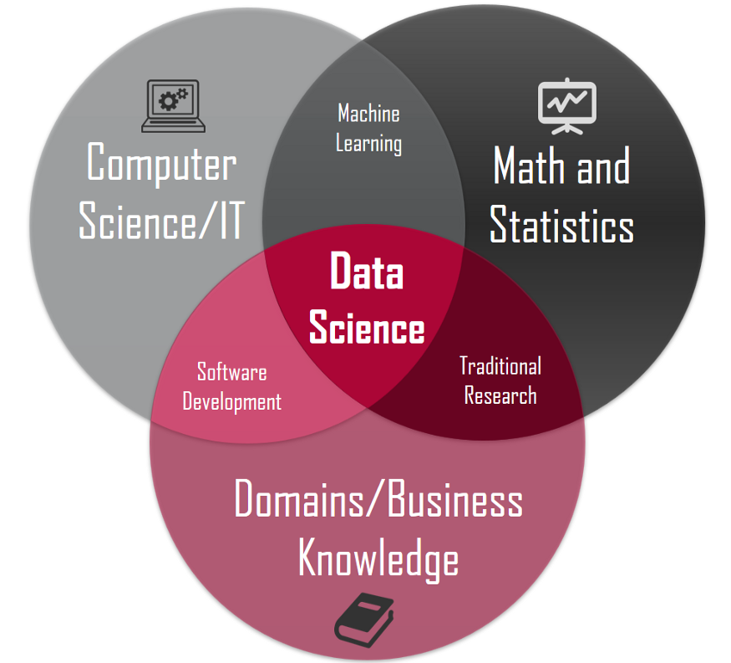
Multidisciplinary field – alternative description
Uncertainty
Causality
R/ Python
This alternative diagram is less popular but shows more acceptable description
Materializing the business opportunity
https://towardsdatascience.com/introduction-to-statistics-e9d72d818745

Slide 5
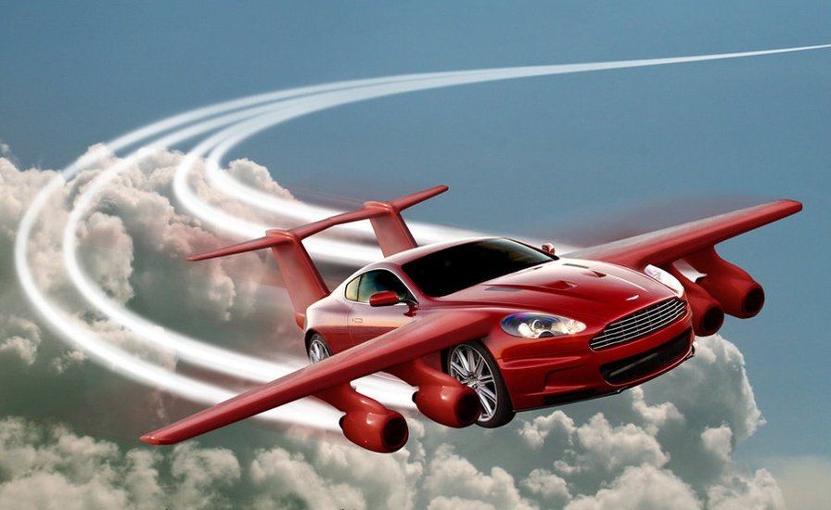
Data Science: analogy to a flying vehicle
The rapid advancement of IT forces us to adjust other areas accordingly
Thrusting: IT
Balancing: Statistics
Directing: Business
Source: https://sourceable.net/degree-in-flying-cars-coming-soon/

Slide 6
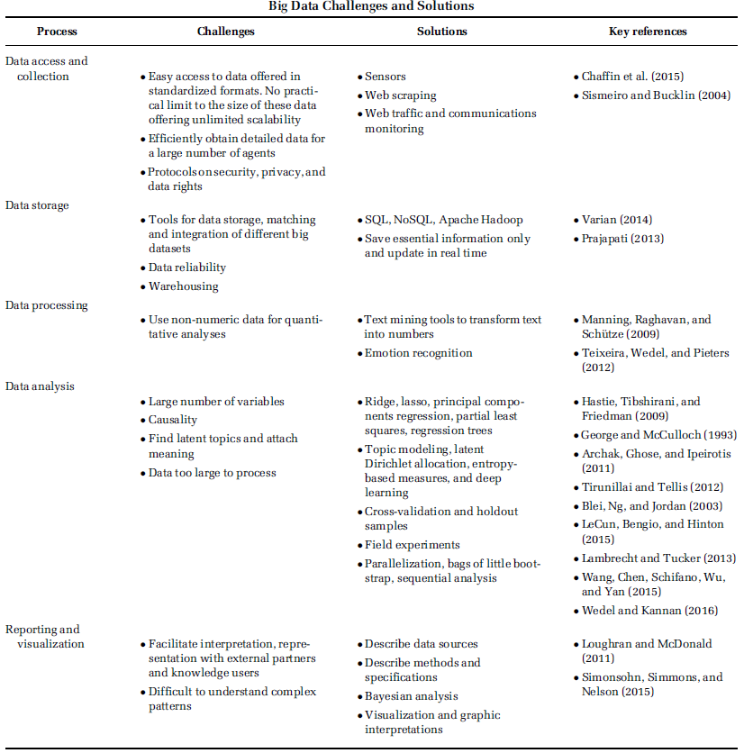
Five processes in Data Science
We will use these five processes as a framework
Source: George et al. (2016). Editorial. Academy of Management Journal

Slide 7
Five processes in Data Science
Access & Collect
Store
Process
Analyse
Report
Sensors
Web scraping
Web traffic and communications monitoring
SQL, NoSQL, Apache Hadoop
Save essential information only
and update in real time
Text mining tools to transform text
into numbers
Emotion recognition
Ridge, lasso, principal components
regression, partial least
squares, regression trees
Deep learning
…
Visualization and graphic interpretation
Robustness check
Open Science

Slide 8
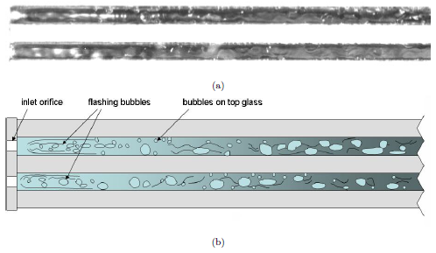
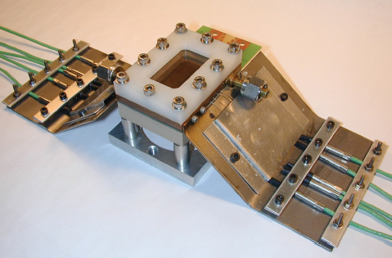
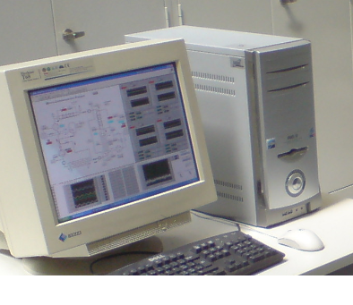
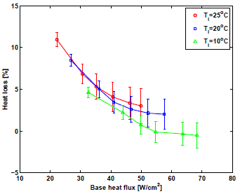


Five processes in Experimental Research in Thermodynamics
Access & Collect
Store
Process
Analyse
Report
Sensors
Web scraping
Web traffic and communications monitoring
SQL, NoSQL, Apache Hadoop
Save essential information only
and update in real time
Text mining tools to transform text
into numbers
Emotion recognition
Ridge, lasso, principal components
regression, partial least
squares, regression trees
Deep learning
…
Visualization and graphic interpretation
Robustness check
Open Science

Slide 9
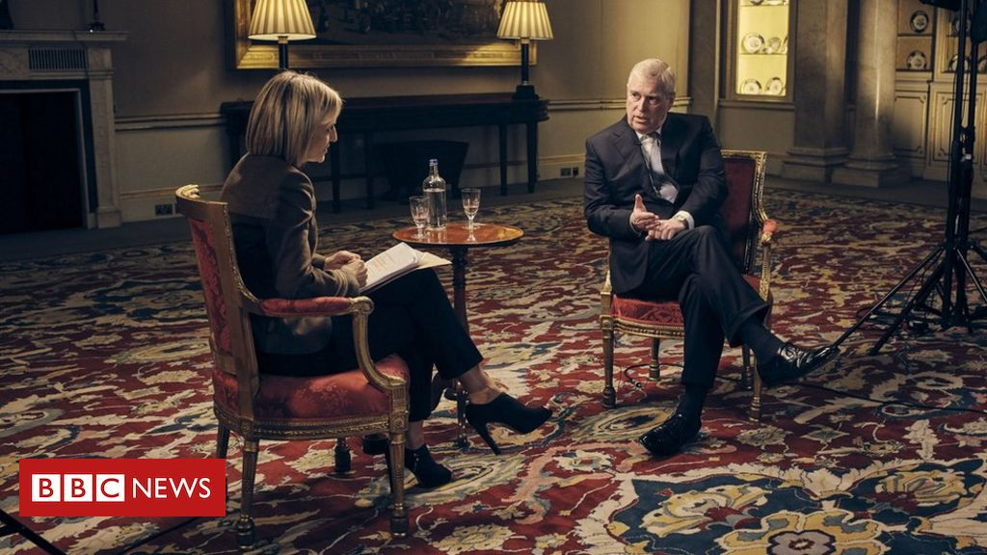
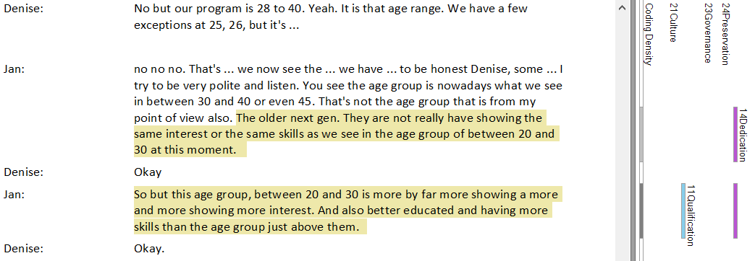
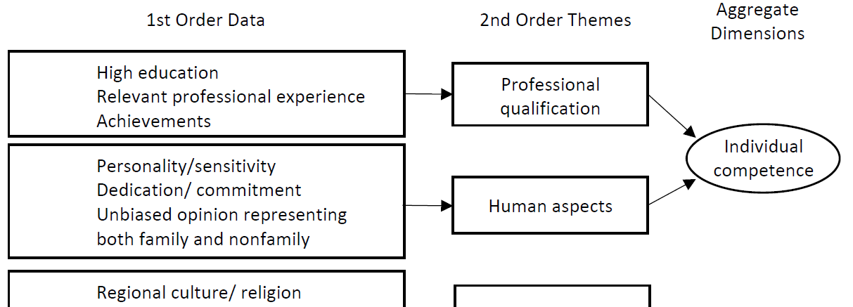
Five processes in Qualitative Management Research
Access & Collect
Store
Process
Analyse
Report
Sensors
Web scraping
Web traffic and communications monitoring
SQL, NoSQL, Apache Hadoop
Save essential information only
and update in real time
Text mining tools to transform text
into numbers
Emotion recognition
Ridge, lasso, principal components
regression, partial least
squares, regression trees
Deep learning
…
Visualization and graphic interpretation
Robustness check
Open Science
Interview or survey
Text-coding
Traditional analytics

Slide 10
New Data is
New Opportunity
Notes:
15min
Question
What are the differences between AI, Data Science and Machine Learning
AI enabling technology, AI based service, Data science research field, data science role, machine learning algorithm, the concept that machine is learning
What is the Deep learning, neural network
Need another presentation
What is the good example of data science
Cambridge analytica, linked in people you may know
Where do you publish data science research?
Science, AI journals
For me, use ds technology to work with Entrepreneurship and family business researchers, to publish in those related journals
Comments on DBT centers work
Is it new subject?
Less than 10 years *some tech are old in engineering.
The term received attention in 2012 HBR journals as the sexiest job in 21c
Experts around
IDIAP, martigny
EPFL
UNIL, IBM researcher

Slide 11
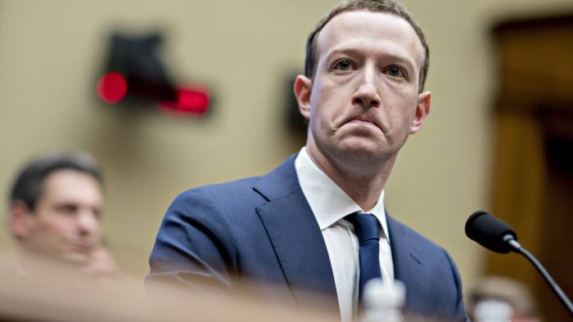
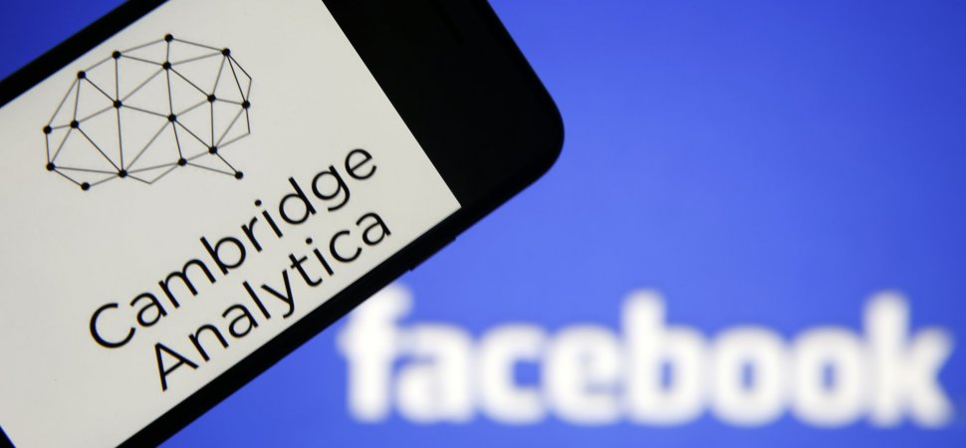
Case: Cambridge Analytica Scandal
Photographer: Chesnot/Getty Images & © Bloomberg

Slide 12
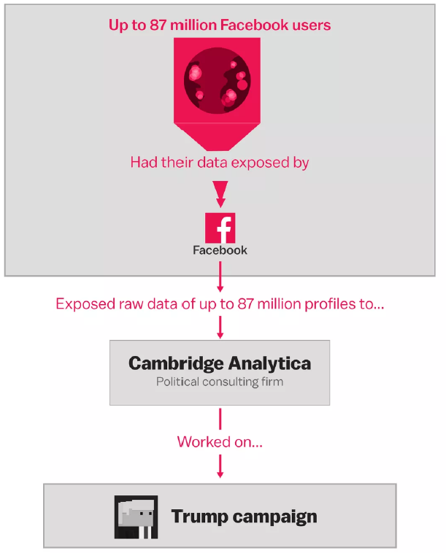
What happened?
Facebook exposed data on up to 87 million Facebook users to a researcher who worked at Cambridge Analytica, which worked for the Trump campaign.
Chang, A. (2018). The Facebook and Cambridge Analytica scandal, explained with a simple diagram. Vox, March, 23.

Slide 13
What happened?
Facebook exposed data on up to 87 million Facebook users to a researcher who worked at Cambridge Analytica, which worked for the Trump campaign.
Chang, A. (2018). The Facebook and Cambridge Analytica scandal, explained with a simple diagram. Vox, March, 23.

Slide 14
Cambridge Analytica
Cambridge Analytica
A scientist used to work at Cambridge University
Latin/ Greek word for “Analytics”
- more "sciency" cool sound to it
A subsidiary of SCL (Strategic Communication Laboratories) which uses the study of mass behaviour and how to change it for commercial, military and political purposes
SCL formed CA to participate in the election process in the United States

Slide 15
Complex relations
Action
Facebook
Facebook users
Trump Campaign
“This is my digital life”
Analytic report
Alexsandre Kogan
Alexander Nix
Steve Bannon
Data
Fund
Rebekah and Robert Mercer

Slide 16
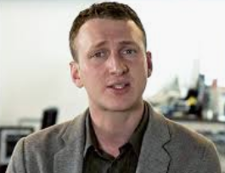
Complex relations
Action
Facebook
Facebook users
Trump Campaign
“This is my digital life”
Analytic report
Alexsandre Kogan
Alexander Nix
Steve Bannon
Data
Fund
Rebekah and Robert Mercer
new data access!

Slide 17
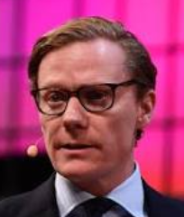
Complex relations
Action
Facebook
Facebook users
Trump Campaign
“This is my digital life”
Analytic report
Alexsandre Kogan
Alexander Nix
Steve Bannon
Data
Fund
New data is
New opportunity!
Rebekah and Robert Mercer

Slide 18
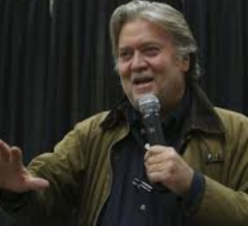
Complex relations
Action
Facebook
Facebook users
Trump Campaign
“This is my digital life”
Analytic report
Alexsandre Kogan
Alexander Nix
Steve Bannon
Data
I know how to materialize opportunities!
Fund
Rebekah and Robert Mercer

Slide 19
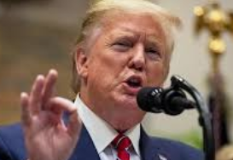
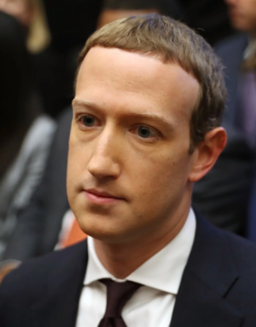
Complex relations
Thank you!
Sorry…
Action
Facebook
Facebook users
Trump Campaign
“This is my digital life”
Analytic report
Alexsandre Kogan
Alexander Nix
Steve Bannon
Data
Fund
Rebekah and Robert Mercer

Slide 20
Our focus is on Data Science
Action
Facebook
Facebook users
Trump Campaign
“This is my digital life”
Analytic report
Data
Cambridge Analytica

Slide 21
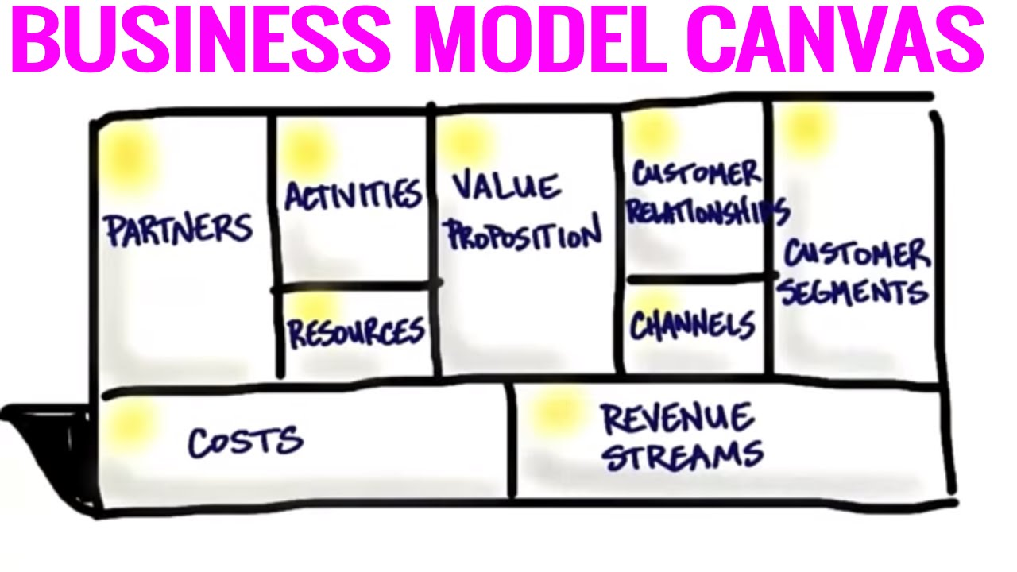
If this were Entrepreneurship discussion…
https://www.youtube.com/watch?v=IP0cUBWTgpY

Slide 22
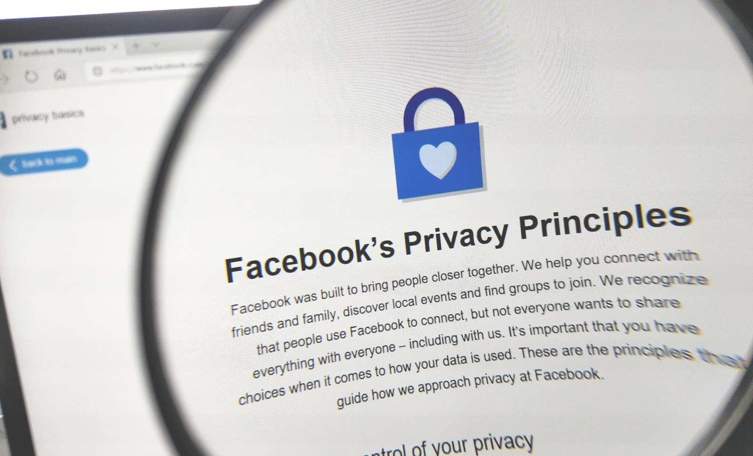
If this were Ethics discussion…
https://scrippsmediaethics.blogspot.com/2018/09/remaining-ethical-in-fake-news.html

Slide 23
Our focus is on Data Science
Access & Collect
Store
Process
Analyse
Report
Sensors
Web scraping
Web traffic and communications monitoring
SQL, NoSQL, Apache Hadoop
Save essential information only
and update in real time
Text mining tools to transform text
into numbers
Emotion recognition
Ridge, lasso, principal components
regression, partial least
squares, regression trees
Deep learning
…
Visualization and graphic interpretation
Robustness check
Open Science
Notes:
25min
The explanation is sufficient to go ahead?
Who is Christopher Wylie, the pink hair
Ex-Cambrid Analytica employee who blew the whistle on the company’s problematic operations in Observer, British news paper.
Intern working 2 days in the office
What happened to them now?
Donnation 15mil

Slide 24
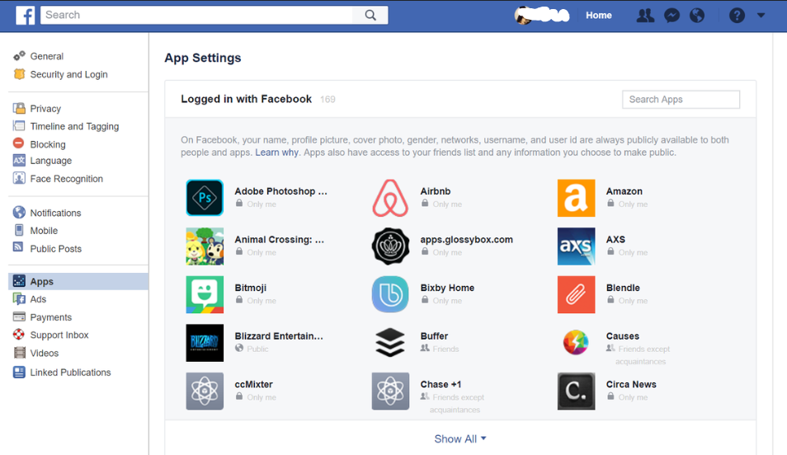

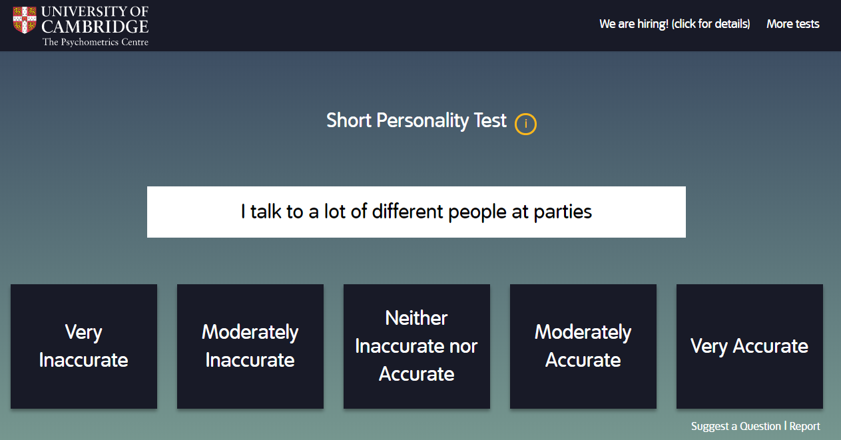
[Data collect] “This is my digital life” App
Download the app
Do your personality test
And get paid!

Slide 25
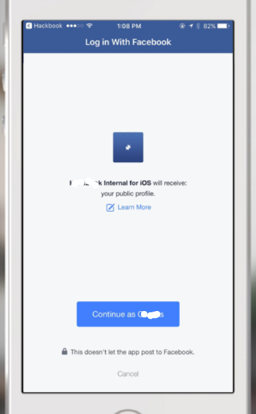
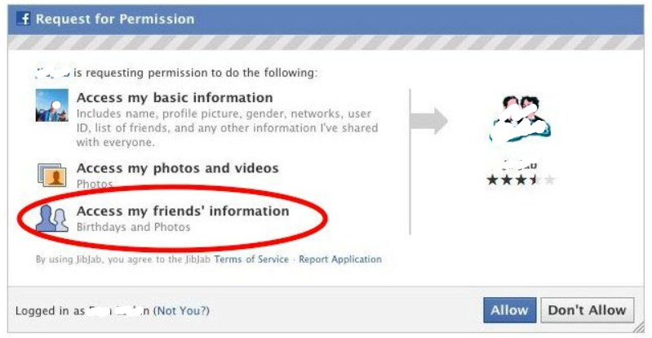
[Data collect] “This is my digital life” App
To be paid, login with Facebook
Facebook has allowed third-party app developers to access some private user data since May 2007, when it first opened the Facebook platform.
An example of what Facebook Login looks like. Facebook

Slide 26
[Data collect] Using API (Application Programming Interface)
(Over-)Simplified definition of API is: a pre-defined way for external users to collect data from a website’s database
Websites like Facebook and Wikipedia provide API to encourages developing a third-party software providing additional services based on the company’s product
Also, providing API can avoid the abuse of data access using a risky (hacking or overloading) method to the server

Slide 27
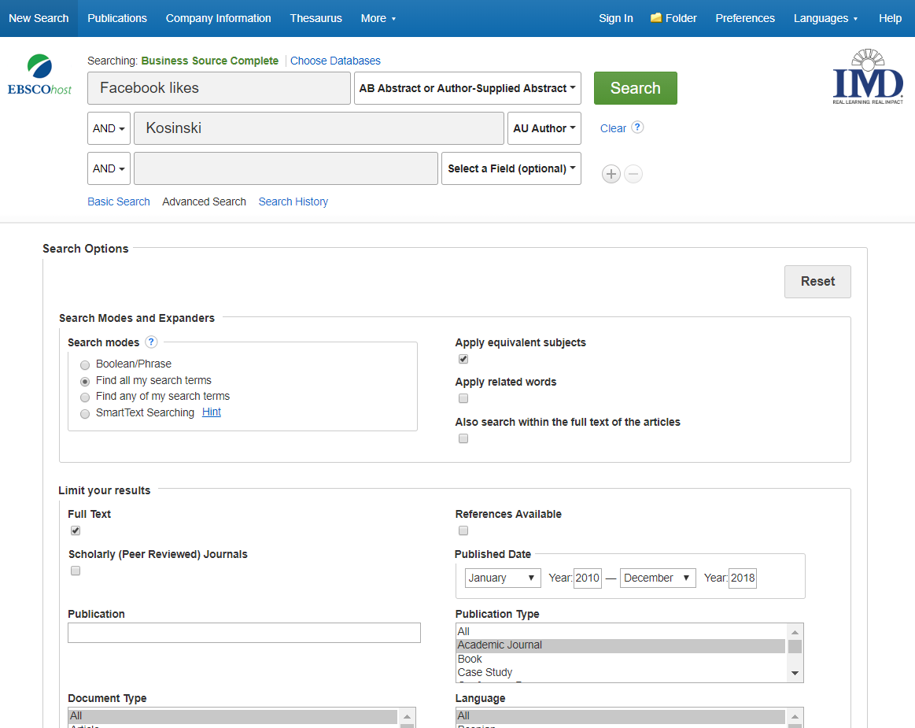
[Data collect] Example of E-Library API
We need to fill in the form to request the relevant information from the library database

Slide 28
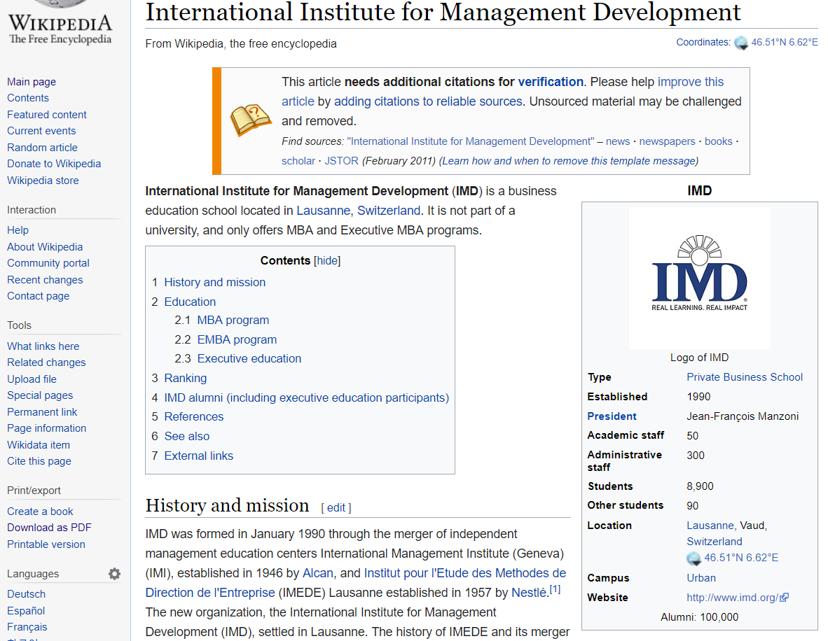
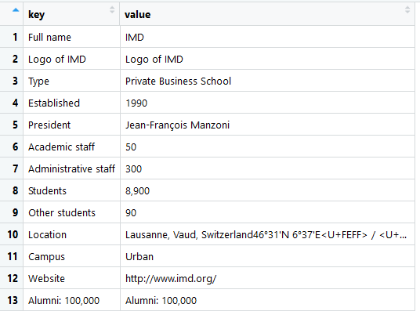
[Data collect] Example of using API ex. R code for collecting table information from Wikipedia
Output

Slide 29
[Data collect] Example of using API ex. R code for collecting table information from Wikipedia
# R code
library(httr)
library(rvest)
library(xml2)
get_infobox <- function(title){
base_url <- "https://en.wikipedia.org/w/api.php"
query_params <- list(action = "parse",
page = title,
format = "xml")
resp <- GET(url = base_url, query = query_params)
resp_xml <- content(resp)
page_html <- read_html(xml_text(resp_xml))
infobox_element <- html_node(x = page_html, css =".infobox")
page_name <- html_node(x = infobox_element, css = ".fn")
page_title <- html_text(page_name)
wiki_table <- html_table(infobox_element)
colnames(wiki_table) <- c("key", "value")
cleaned_table <- subset(wiki_table, !wiki_table$key == "")
name_df <- data.frame(key = "Full name", value = page_title)
wiki_table <- rbind(name_df, cleaned_table)
wiki_table
}
get_infobox(title = "International Institute for Management Development")
Call some packages
Define a function get_infobox
We will use wikipedia api
Send query parameters and receive data
Rearrange the data into a table form
Call the function for “IMD” wikipage

Slide 30
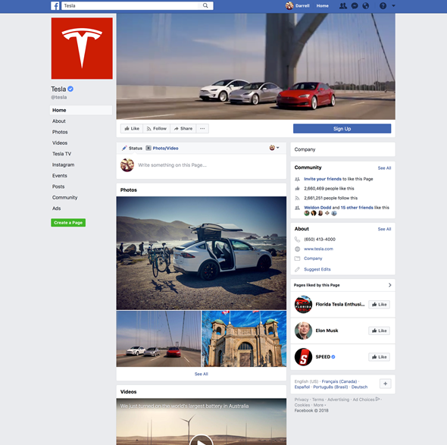

[Data collect] Data collected from “This is my digital life” App
270k users’
Facebook likes
& Personality test results
87mil users’ (friends)
Facebook likes
& ...
+ Facebook profiles (names, address, etc)

Slide 31
Our focus is on Data Science
Access & Collect
Store
Process
Analyse
Report
Sensors
Web scraping
Web traffic and communications monitoring
SQL, NoSQL, Apache Hadoop
Save essential information only
and update in real time
Text mining tools to transform text
into numbers
Emotion recognition
Ridge, lasso, principal components
regression, partial least
squares, regression trees
Deep learning
…
Visualization and graphic interpretation
Robustness check
Open Science

Slide 32
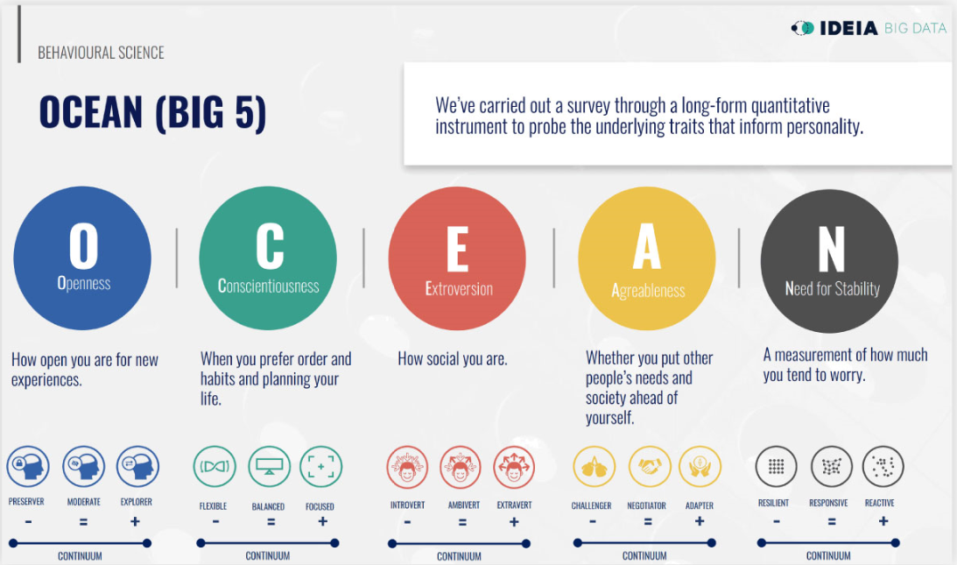
[Data Analysis] Psychographics – Personality Test Results

Slide 33
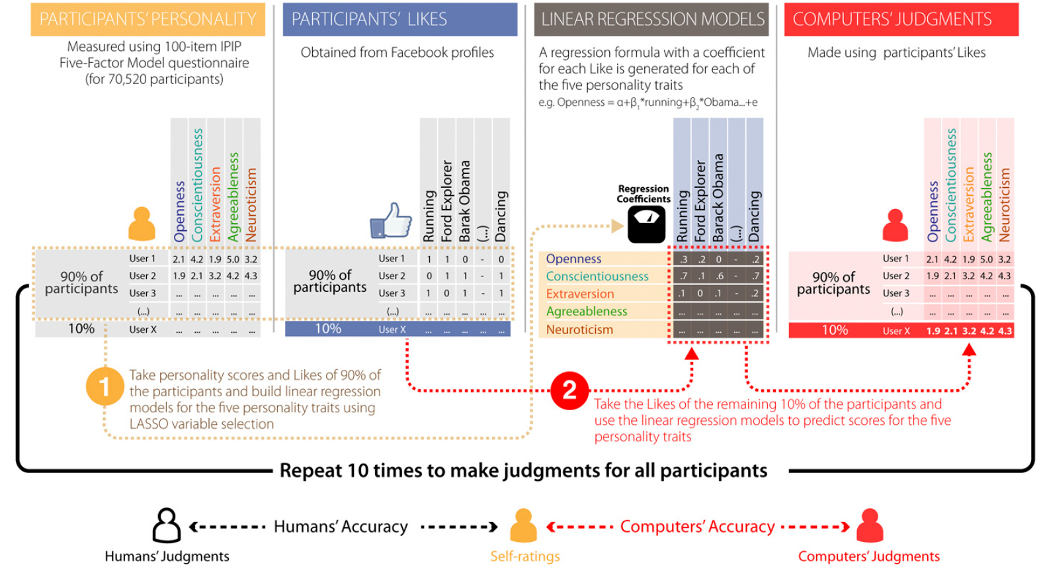
[Data Analysis] Regression models
Youyou, W., Kosinski, M., & Stillwell, D. (2015). Computer-based personality judgments are more accurate than those made by humans. Proceedings of the National Academy of Sciences, 112(4), 1036-1040.

Slide 34
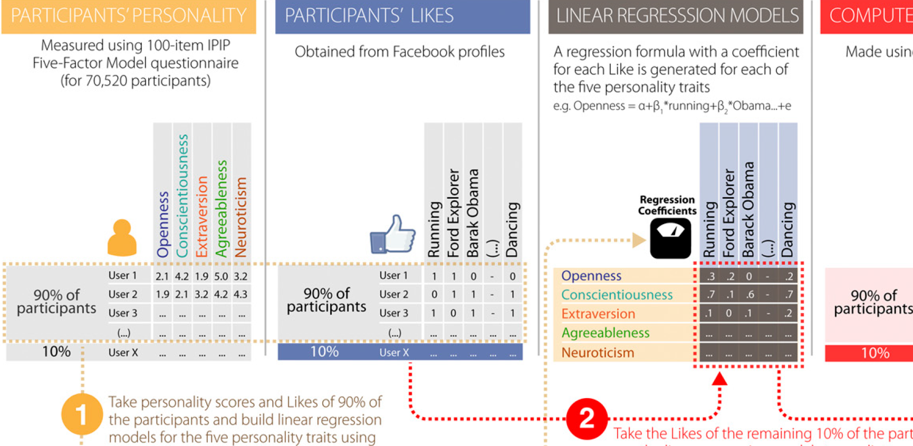

Slide 35
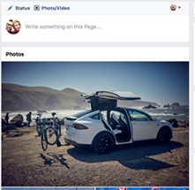
Demo: 1) Make your “pseudo-Facebook Likes”
Go to bit.ly/imddemoca
Enter any nick name: hulk, hermione, wolverine,..
Click “Likes” or skip for the 10 postings as you feel like
Enter age and gender
Interesting and relevant to you?
or SKIP

Slide 36
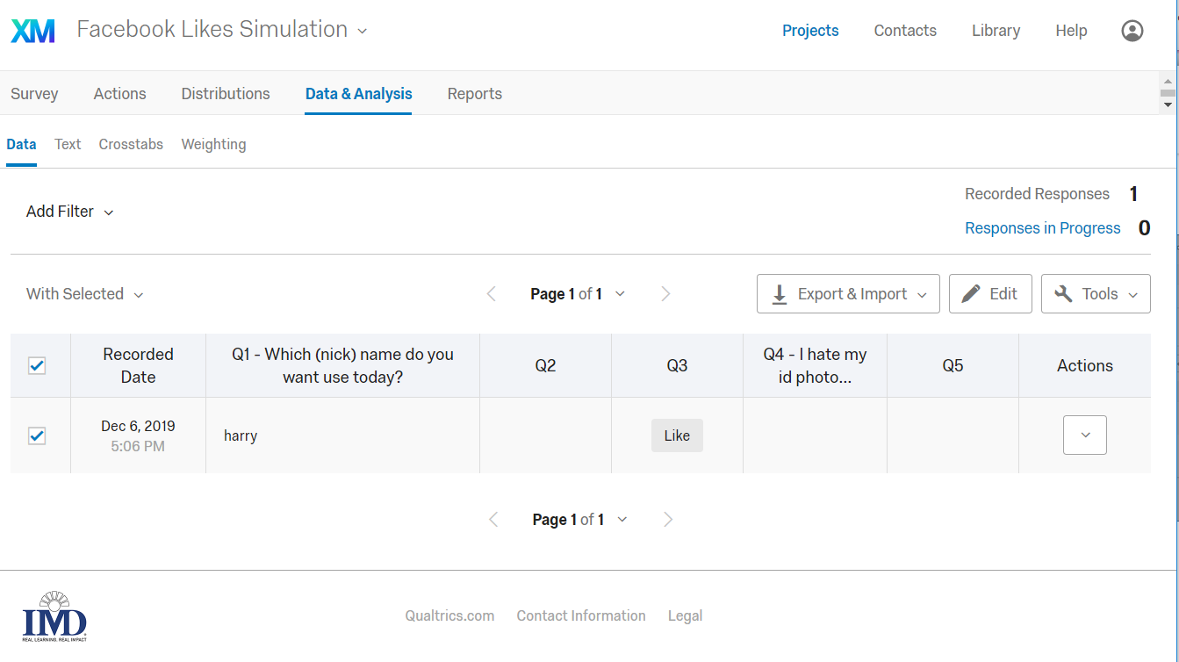
Demo: 2) Downloading the data

Slide 37
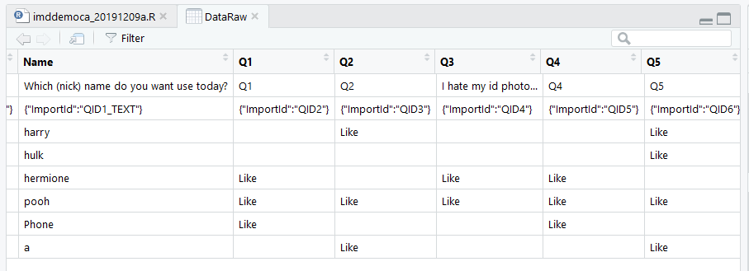
Demo: 3) Import Data

Slide 38
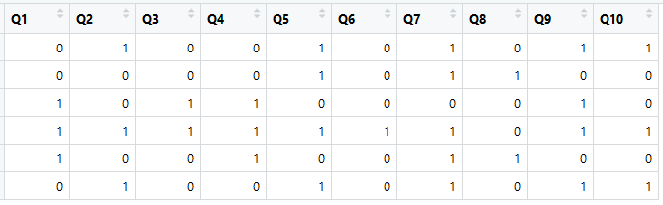
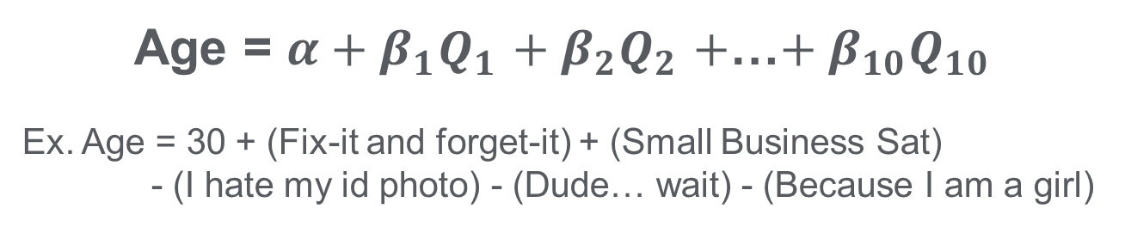
Demo: 4) Process the data, Do regression and Predict Age/ Gender
Age = $α+β_{1}Q_{1}$ $+{ β}_{2}Q_{2}$ $+$…$+ β_{10}Q_{10}$
Ex. Age = 30 + (Fix-it and forget-it) + (Small Business Sat)
- (I hate my id photo) - (Dude… wait) - (Because I am a girl)

Slide 39
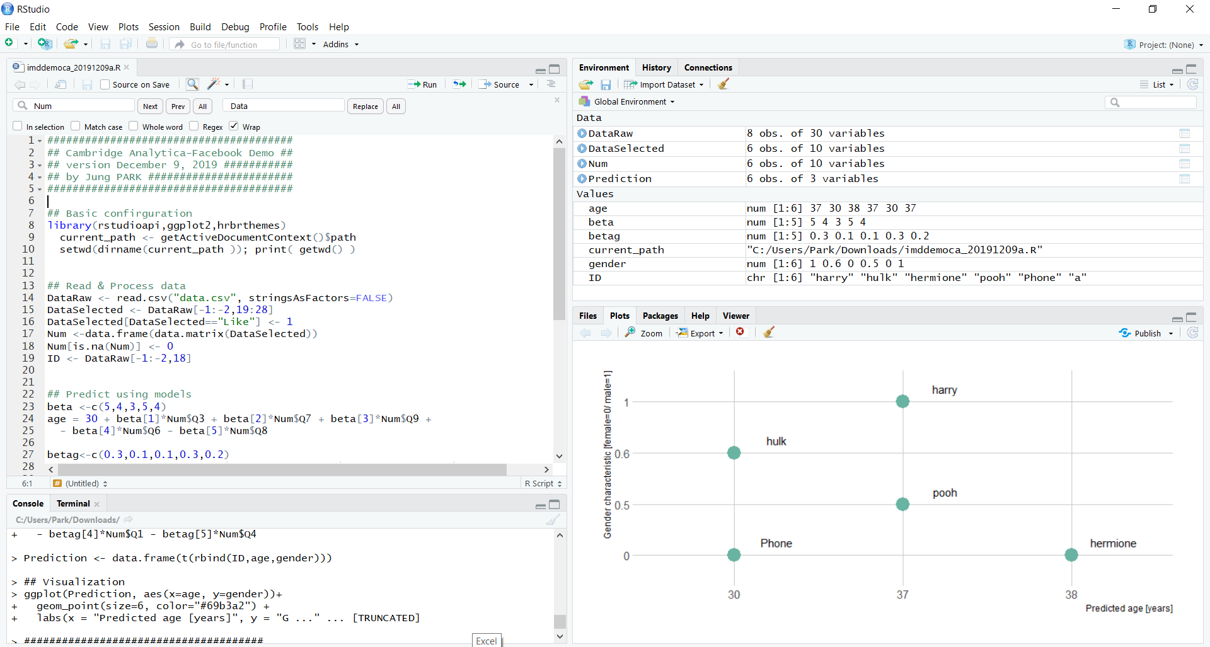
Demo: 5) Plot graphs

Slide 40
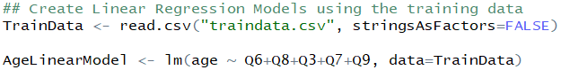
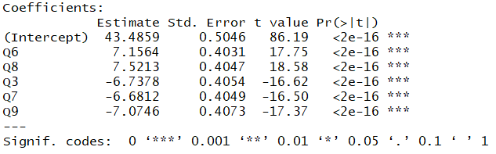
Demo: 6) Regression using Training data

Slide 41
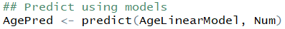
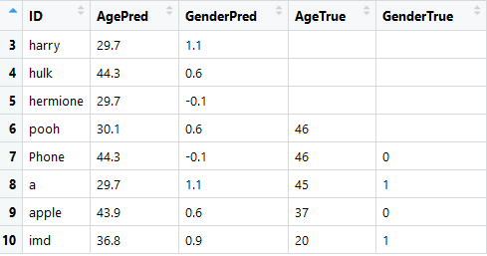
Demo: 7) Regression using Training data

Slide 42
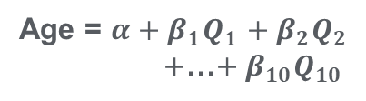
[Data Analysis] Regression models
Training data
270k users’
Facebook likes
&
Personality test results
New data
87mil users’
Facebook likes
Personality test results
Predictive model
Age = $α+β_{1}Q_{1}$ $+{ β}_{2}Q_{2}$
$+$…$+ β_{10}Q_{10}$

Slide 43
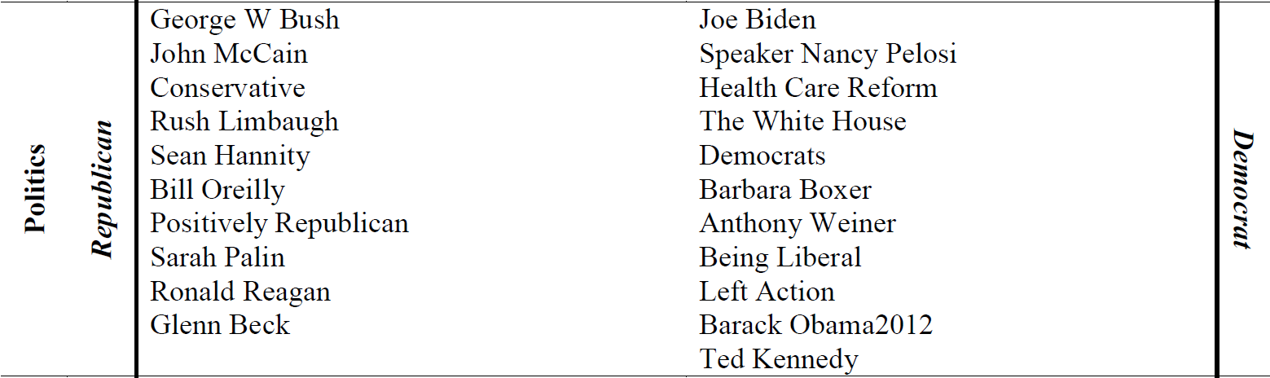
Political views: selected most predictive Likes
Selected most predictive Likes
Some obvious words
Kosinski, M., Stillwell, D., & Graepel, T. (2013). Private traits and attributes are predictable from digital records of human behavior. Proceedings of the National Academy of Sciences, 110(15), 5802-5805.

Slide 44
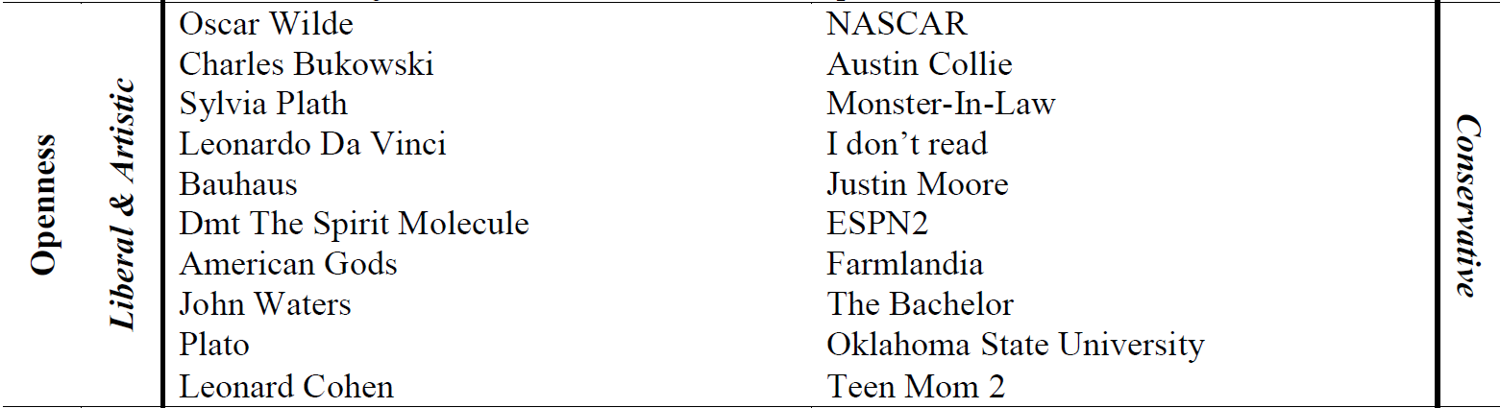
Openness: selected most predictive Likes
Selected most predictive Likes
Some less obvious words
based on US data
Kosinski, M., Stillwell, D., & Graepel, T. (2013). Private traits and attributes are predictable from digital records of human behavior. Proceedings of the National Academy of Sciences, 110(15), 5802-5805.

Slide 45
Our focus is on Data Science
Access & Collect
Store
Process
Analyse
Report
Sensors
Web scraping
Web traffic and communications monitoring
SQL, NoSQL, Apache Hadoop
Save essential information only
and update in real time
Text mining tools to transform text
into numbers
Emotion recognition
Ridge, lasso, principal components
regression, partial least
squares, regression trees
Deep learning
…
Visualization and graphic interpretation
Robustness check
Open Science
Notes:
45min, any question for the demo
In reality, millions of different photo?
Real data is dirty. Not clear. We have to clear out a lot.
Ex. less than 20 likes data removed
Visual examination on the ethnic group

Slide 46
[Use of the analytics] Psychographics – Personality Test Results

Slide 47
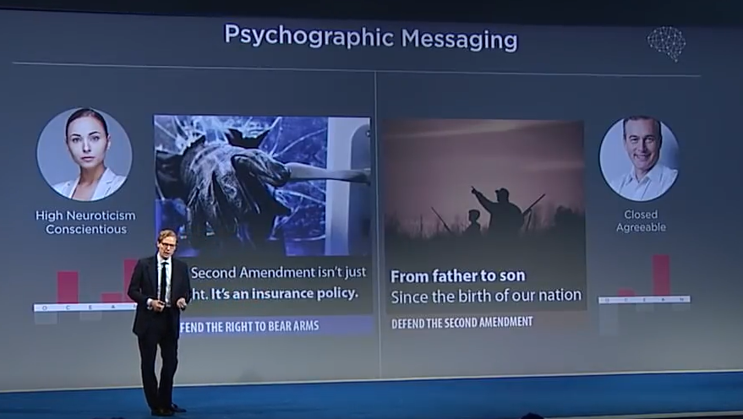
[Use of the analytics] choosing the most effective message
Anxious type would respond to messages highlighting the threat of a break-in
Traditional person could be targeted with messages about a grandfather teaching subsequent generations to hunt
On gun rights issue
https://www.youtube.com/watch?v=n8Dd5aVXLCc&t=126s

Slide 48
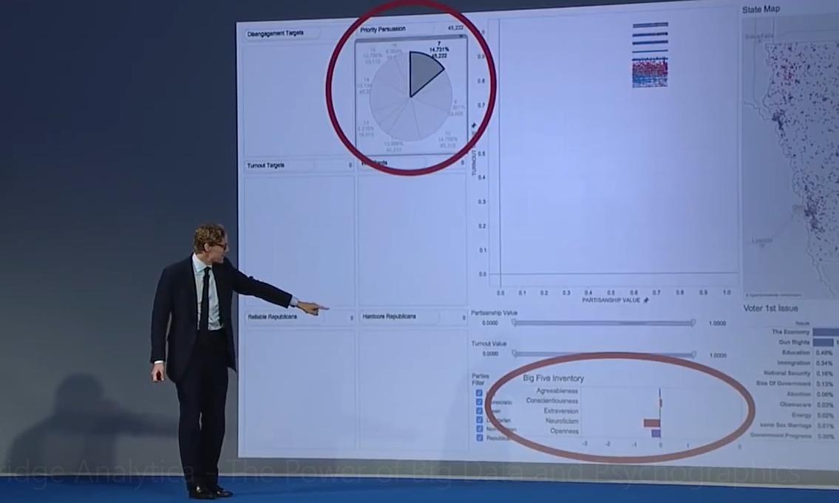
[Use of the analytics] finding the campaign targets
At the 2016 Concordia Annual Summit in New York, Mr. Alexander Nix discusses the power of big data in… behavioral microtargeting for election processes around the world.
https://www.youtube.com/watch?v=n8Dd5aVXLCc&t=126s

Slide 49
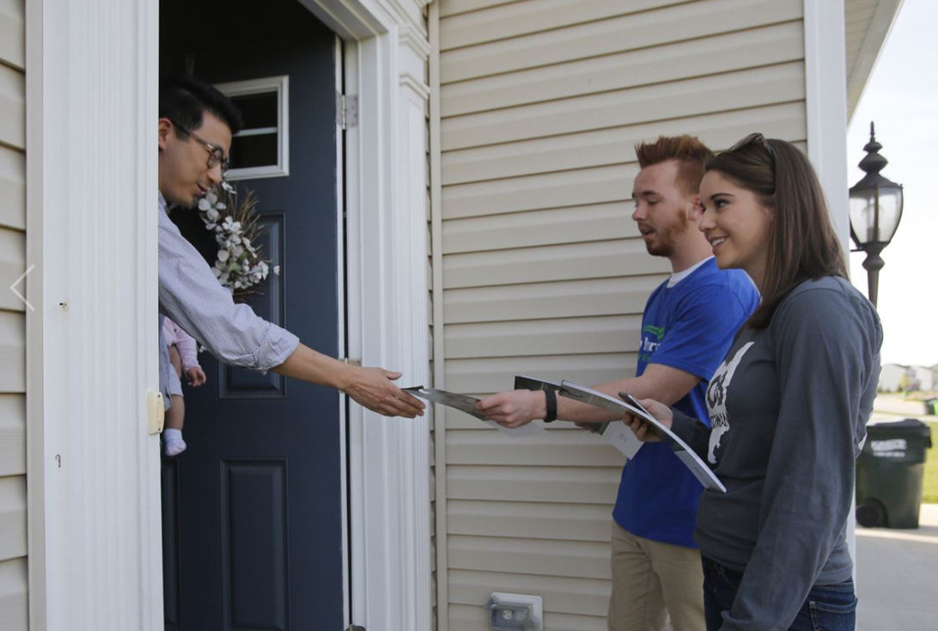
[Use of the analytics] finding the campaign targets
Visit targets who
1) are most likely to vote
2) may swing
With the most effective messages for their personality types
https://www.toledoblade.com/Politics/2016/05/17/Campaigns-looking-to-technologyto-harvest-voters-habits-target-ads.html

Slide 50
Additional food for thought
Do the psychographic predictions actually work well? How much contribution did Cambridge Analytica make to the republican’s win?
Why did Alexander Nix (CA’s CEO) present CA’s involvement in the election at several conferences and sales meetings? Didn’t he expect that he could be accused of it?
Implication to your business?
Notes:
Any comments,
Discuss
Share viewpoints

Slide 51
New Data is
New Opportunity

Slide 52
New Data is
New Opportunity
and New Risk!

Slide 53
Any questions?
Access & Collect
Store
Process
Analyse
Report
Dirty…
Sensors
Web scraping
Web traffic and communications monitoring
SQL, NoSQL, Apache Hadoop
Save essential information only
and update in real time
Text mining tools to transform text
into numbers
Emotion recognition
Ridge, lasso, principal components
regression, partial least
squares, regression trees
Deep learning
…
Visualization and graphic interpretation
Robustness check
Open Science
App
Permission
API
Programming
Regression
Predictive models
Microtargeting
Messages per personality type
Notes:
Question
What is your plan for this research

Slide 54
Appendix (in case of a technical problem)

Slide 55


Simulating Facebook Likes
Q1 Q2
https://www.bizjournals.com/phoenix/news/2017/01/30/wet-seal-closing-remaining-arizona-locations.html
https://www.ksfy.com/content/news/ESPN-Caesars-Entertainment-ink-sports-betting-deal-509912801.html

Slide 56
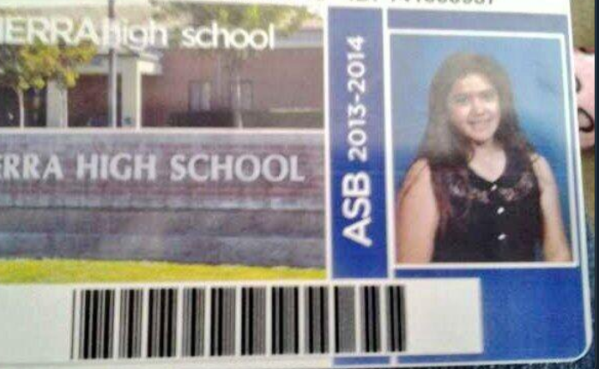

Simulating Facebook Likes
Q3 Q4
I hate my id photo…
https://www.pinterest.ch/pin/349451252316384401
https://twitter.com/mariaforever12/status/365220589717311488

Slide 57


Simulating Facebook Likes
Q5 Q6
https://www.amazon.in/Bruce-Lee-Fight-Tin-Sign/dp/B00MHRBKIA
https://www.amazon.com/Fix-Forget-Cookbook-Ranck-Hower-ebook/dp/B00RW2UVPS

Slide 58

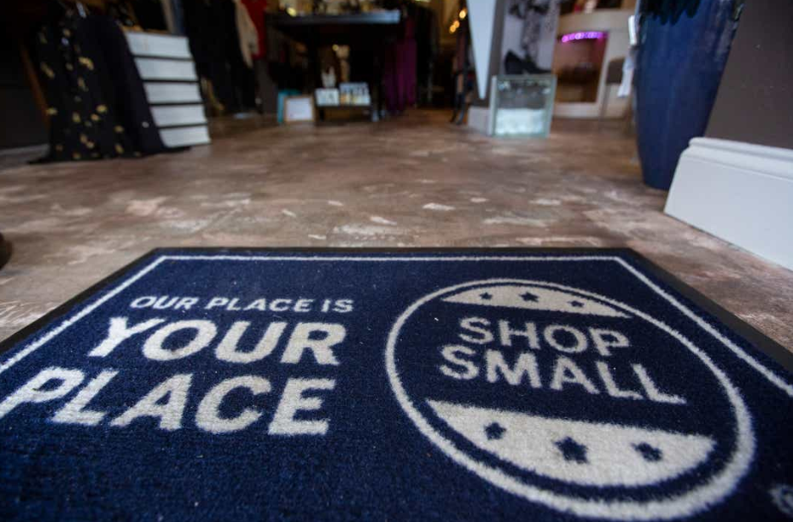
Simulating Facebook Likes
Q7 Q8
Small Business Saturday
https://me.me/i/dude-wait-what-3243555
https://eu.usatoday.com/story/money/2019/11/29/museum-store-sunday-small-business-saturday-2019-holiday-shopping/4331921002/

Slide 59
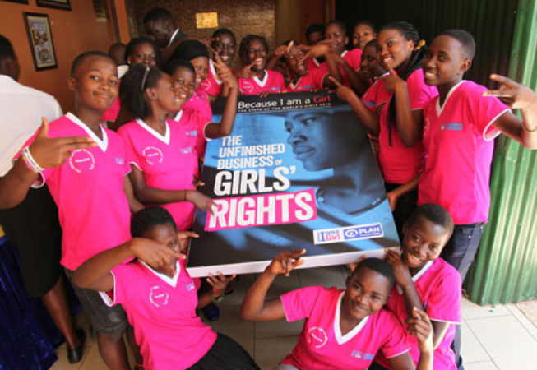

Simulating Facebook Likes
Q9 Q10
Because I am a girl movement
https://plan-international.org/because-i-am-a-girl
https://www.imdb.com/title/tt0185906/mediaviewer/rm1833146624

Slide 60
Simulating Facebook Likes: (over-)simplified version for hand calculation
Age = 30 + 5*(Q6+Q8
-Q3-Q7-Q9)
Gender = 0.5+ 0.2*(Q2+Q5+Q10
-Q1-Q4)
Likes = 1, Skip = 0

